Slide 1
Power BI – HR Analytics in 3 Hours

Slide 2
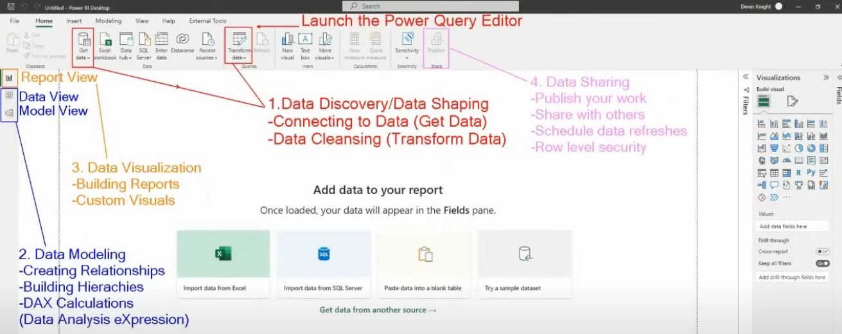

Slide 3
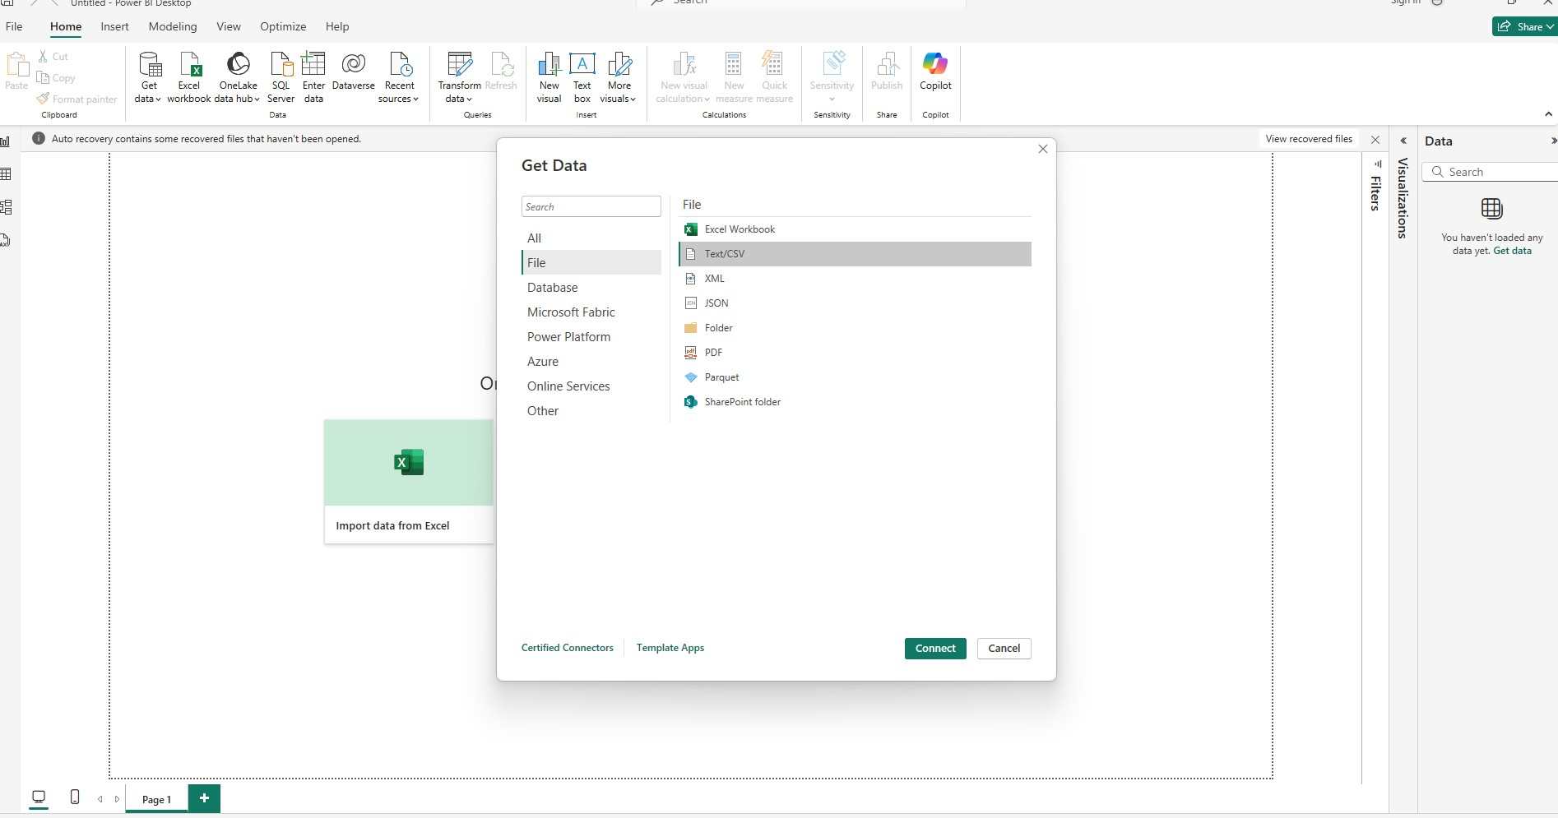
Get CSV data
Last step

Slide 4
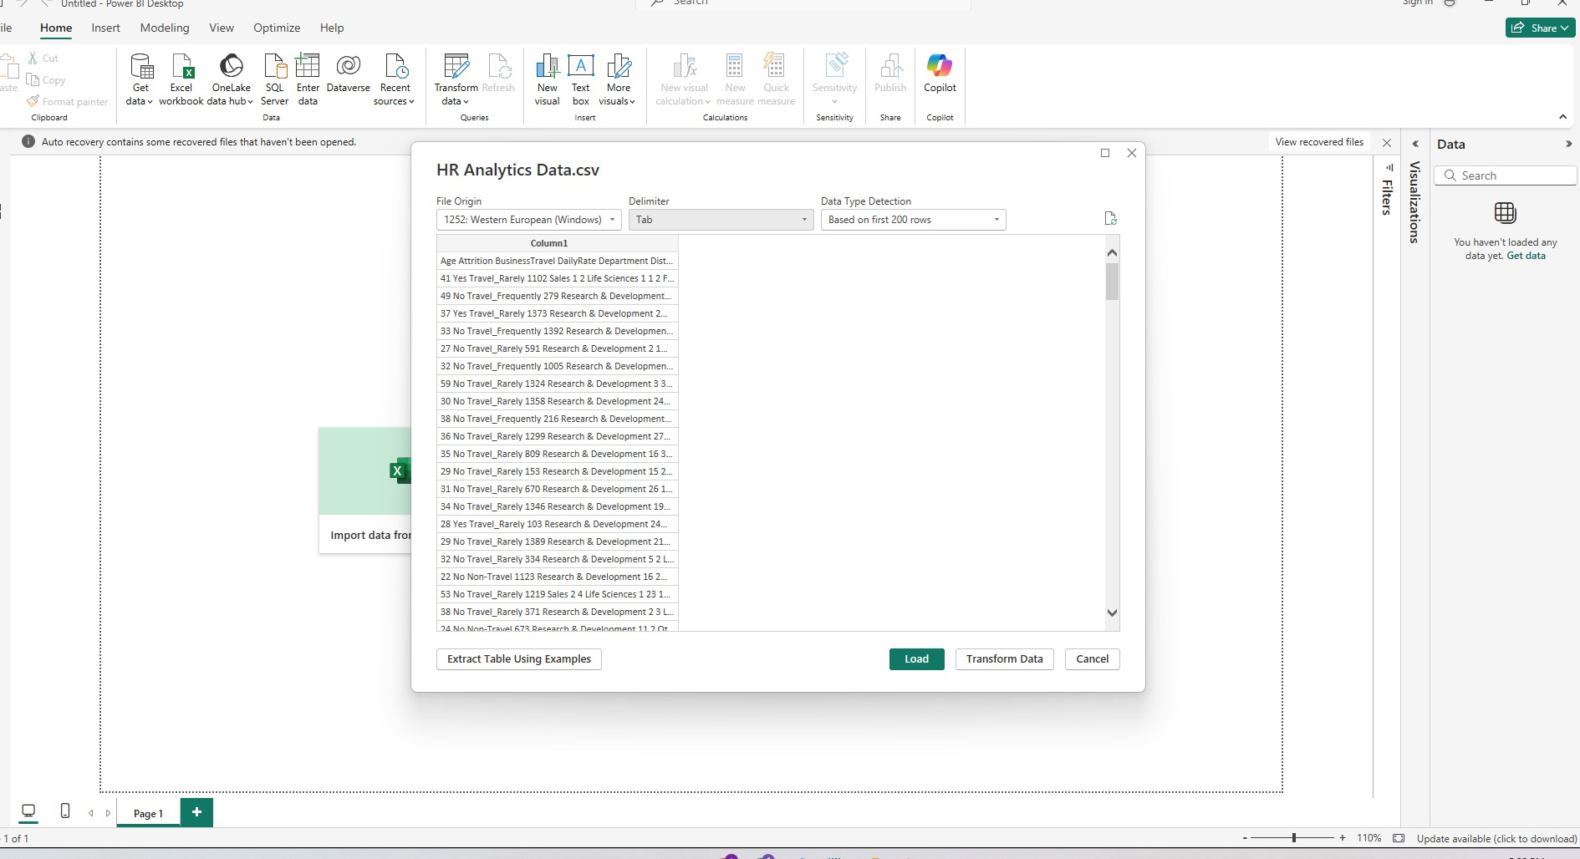
2) Use Tab delimiter
Last step : Click Transform data

Slide 5
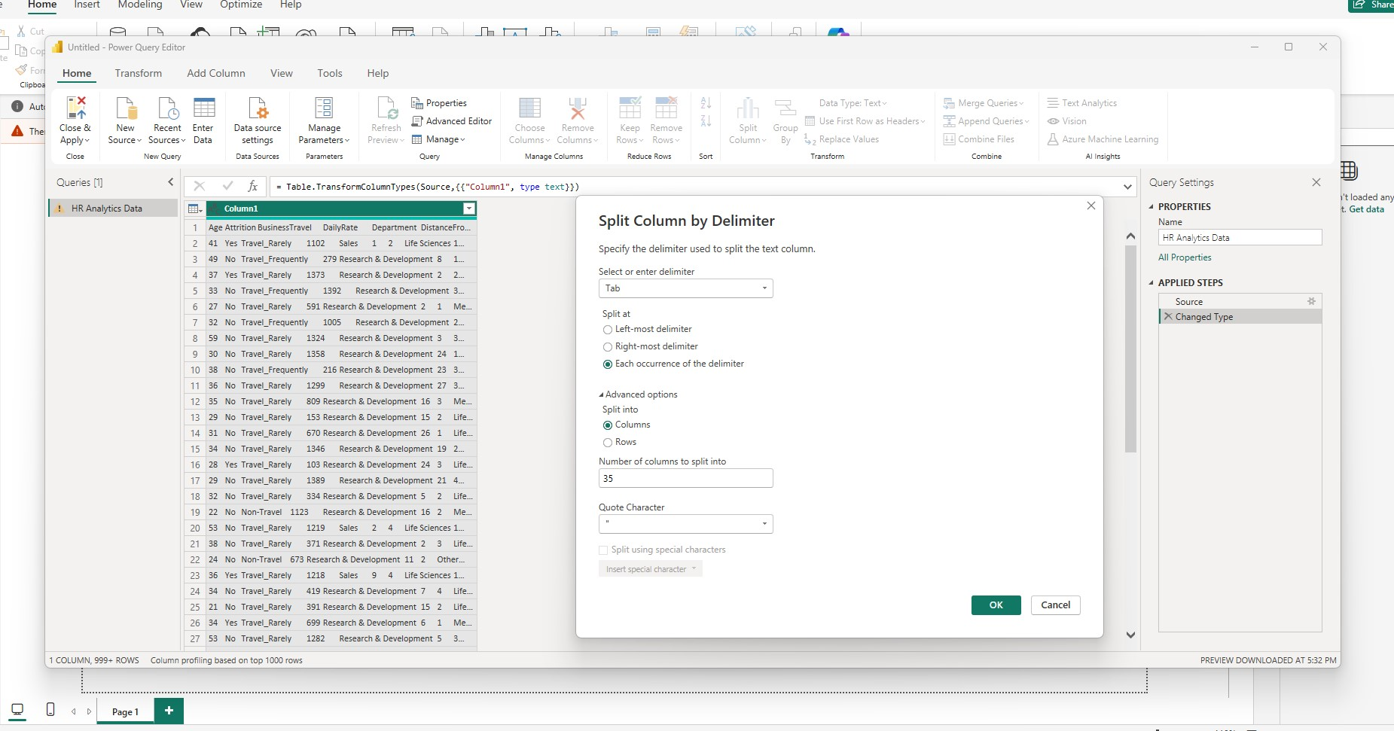
Last step

Slide 6
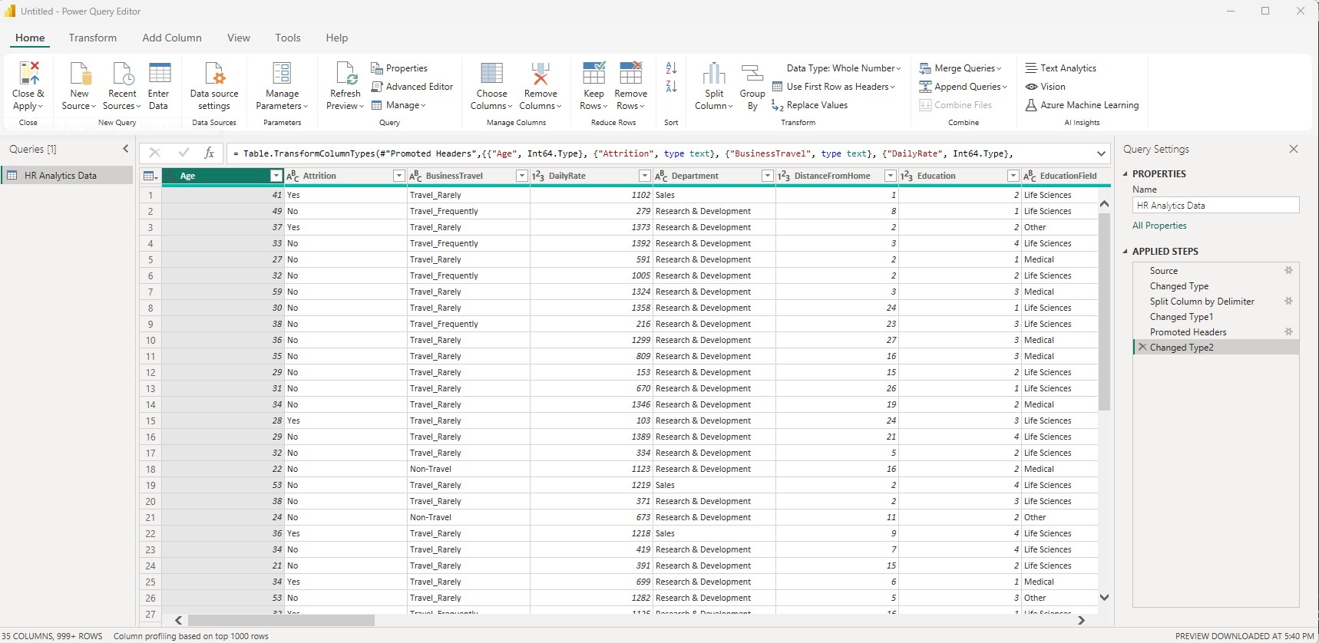
Last step

Slide 7
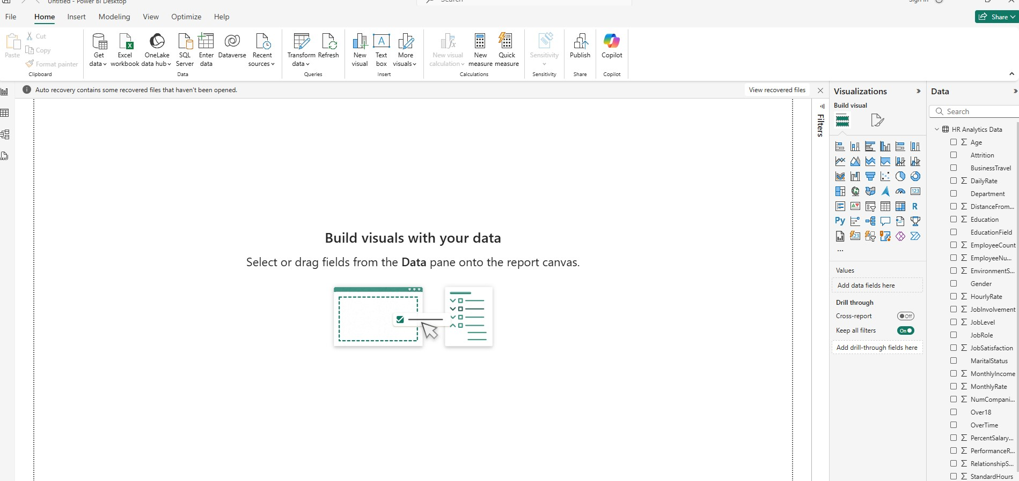

Slide 8
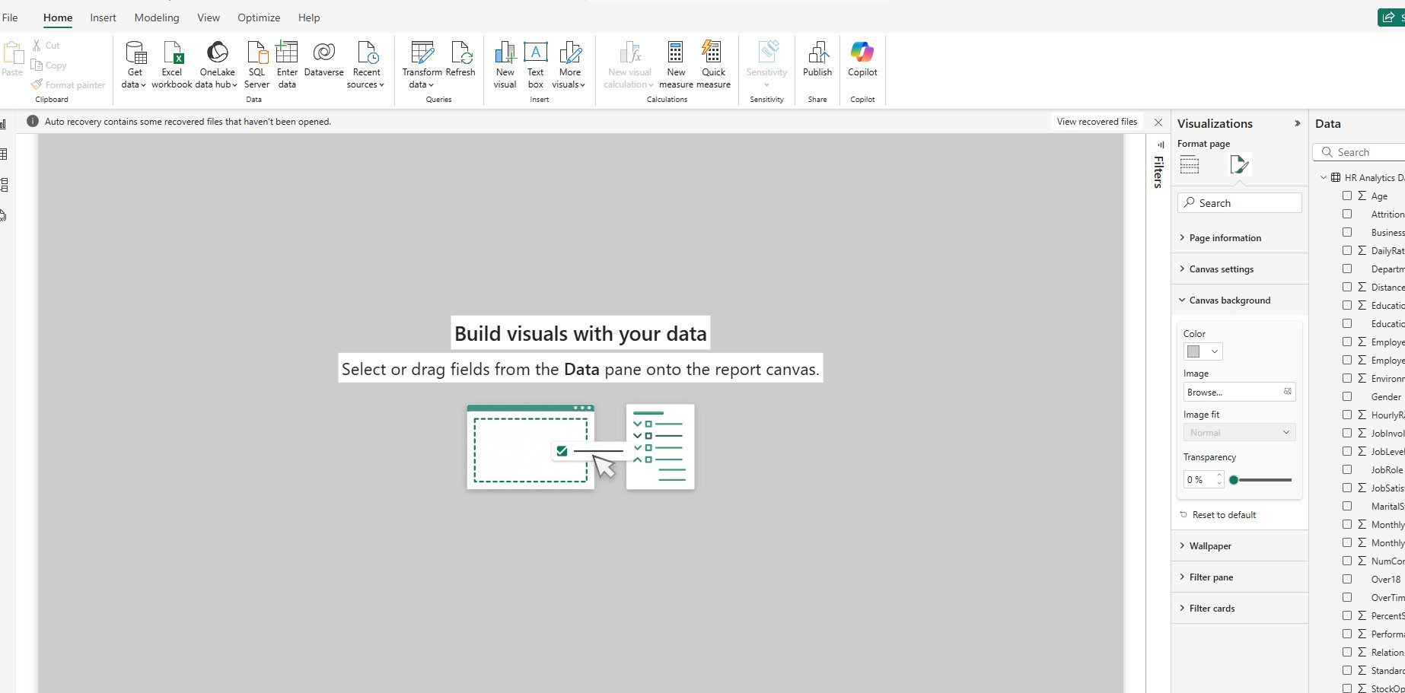
Last step

Slide 9
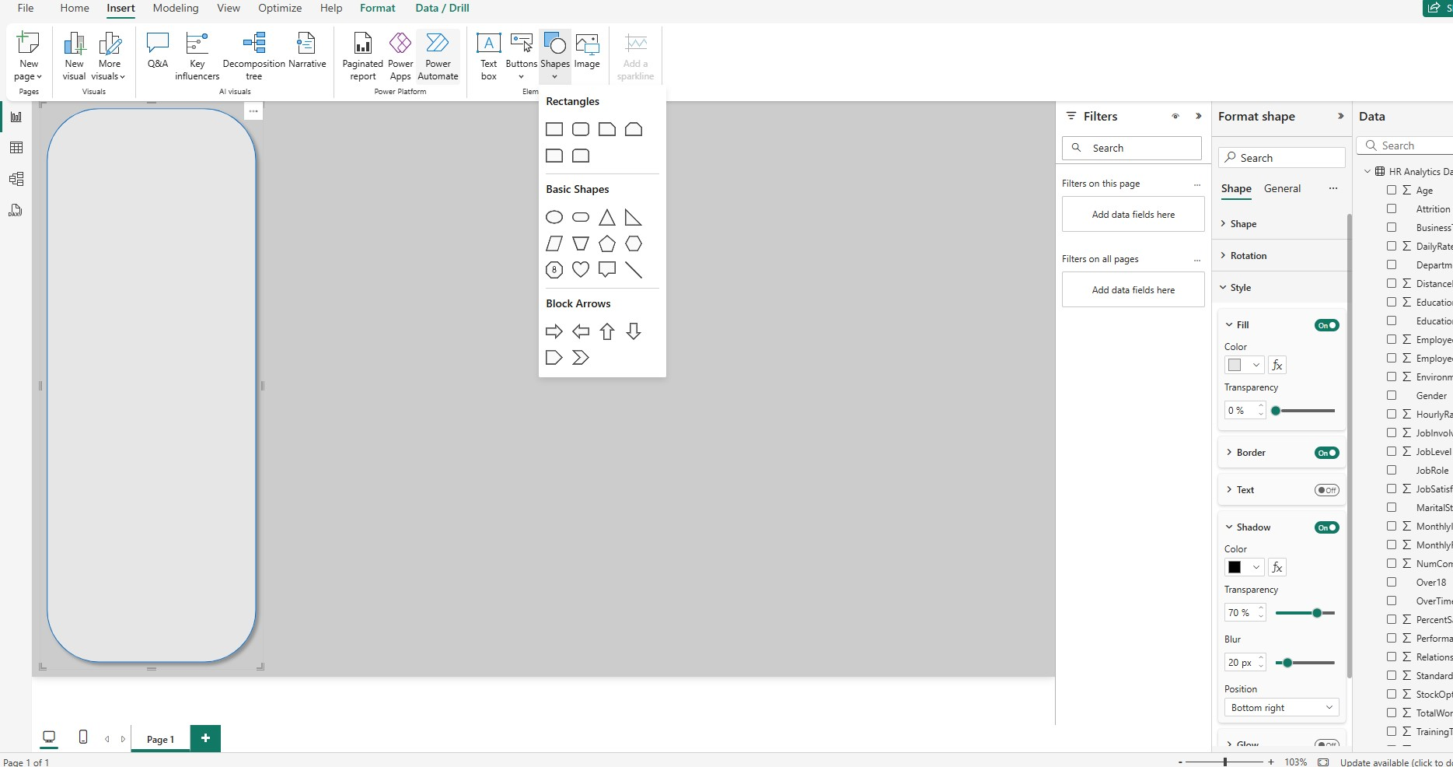

Slide 10
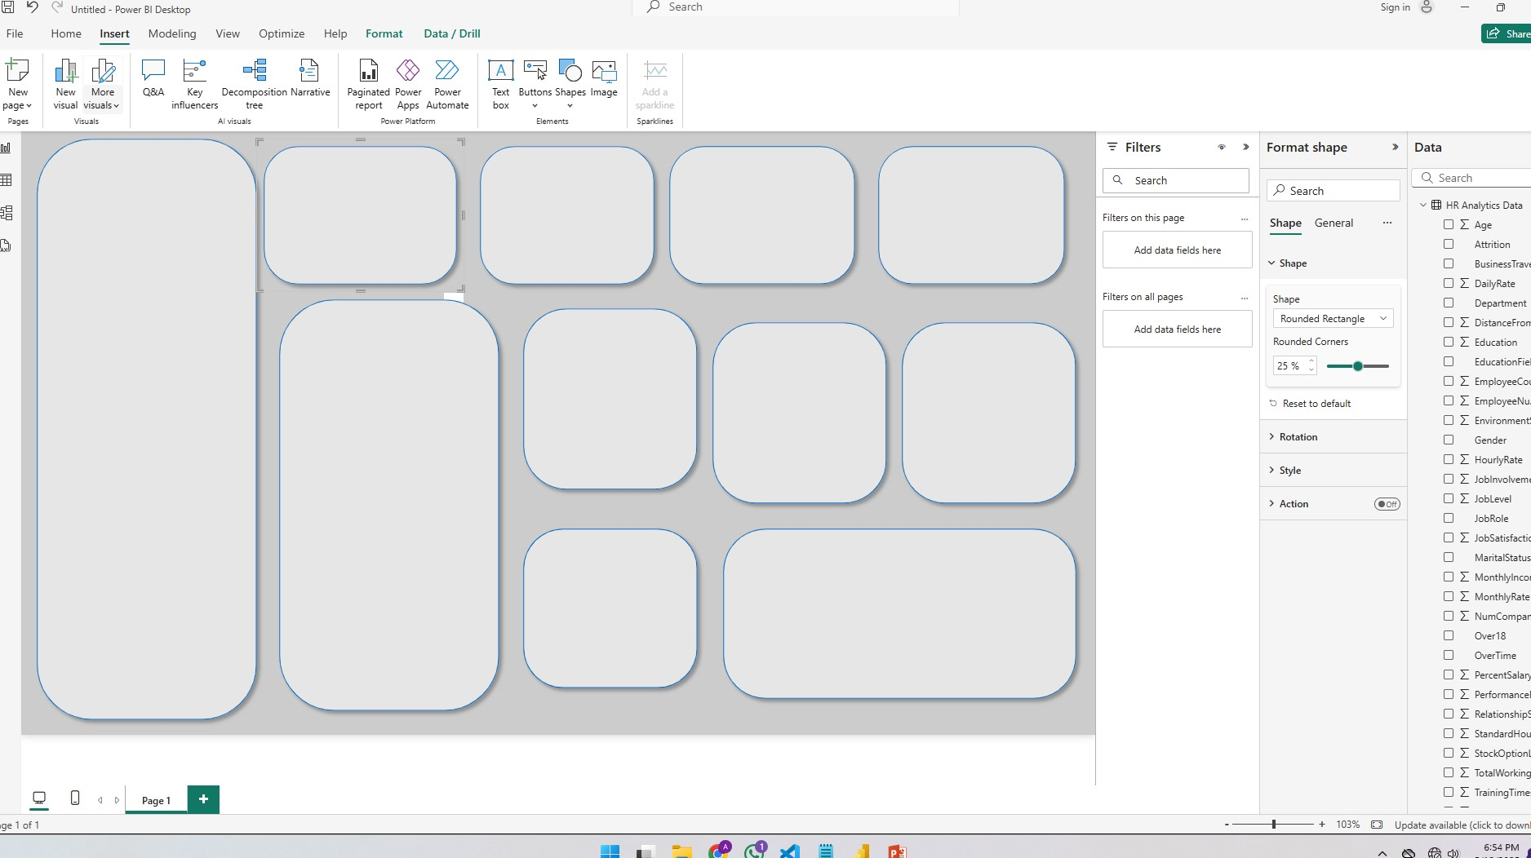
Using copy and paste, create following layout.

Slide 11
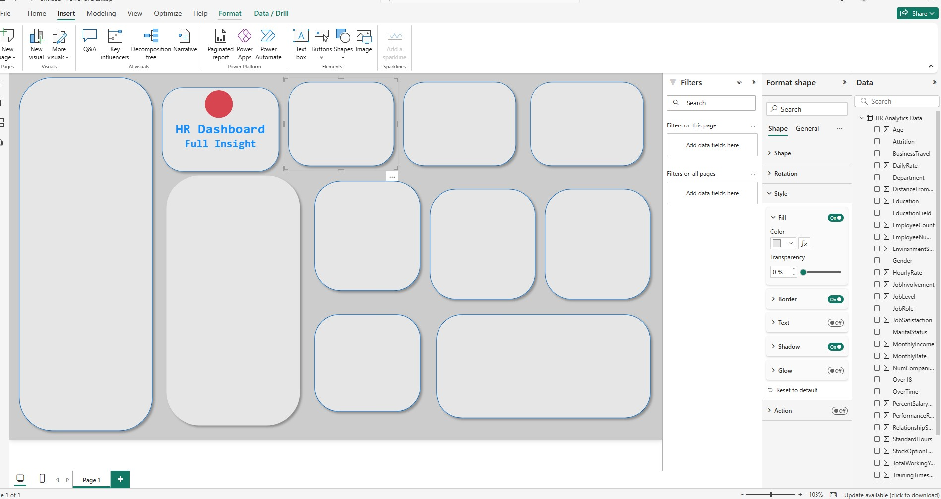
Last step
We copy + paste above text box

Slide 12
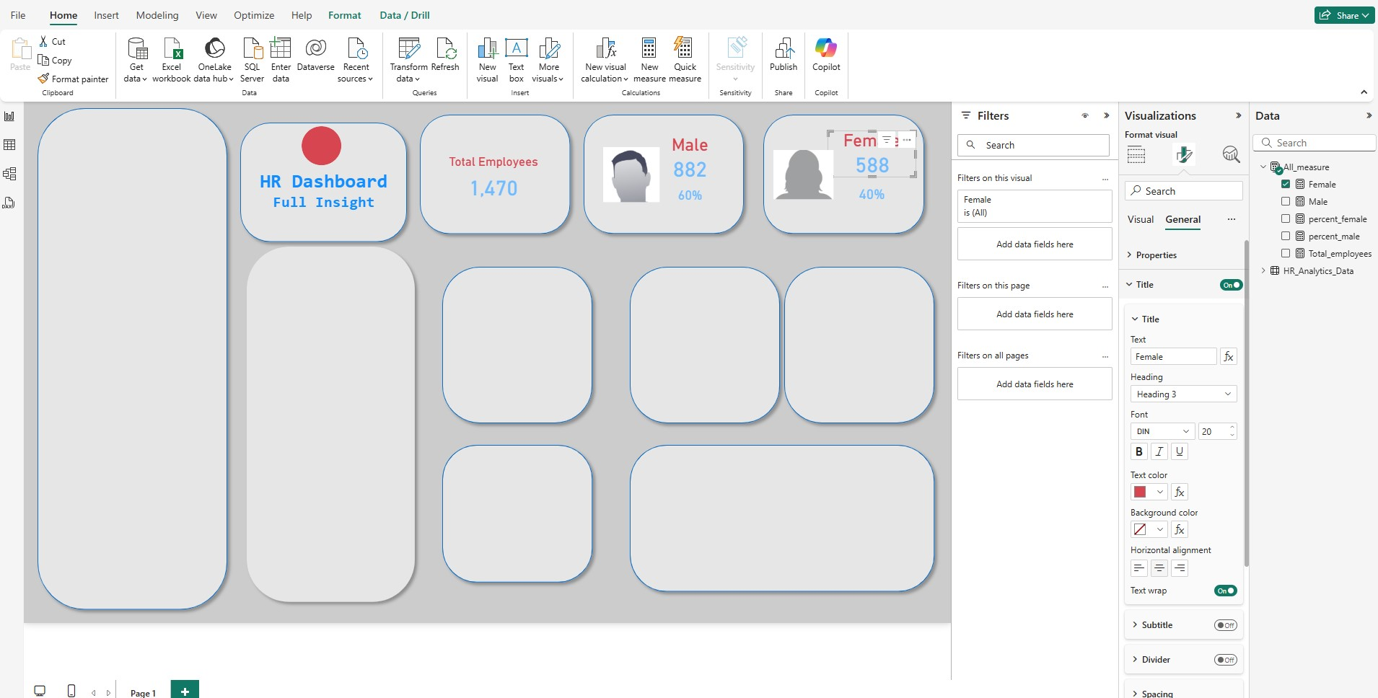
1) Now we add a table (Home->Enter Data): Rename it to All_measure….then load, do not have to add a/t
2) Add following new measures:
- Total_employees = COUNTROWS('HR_Analytics_Data') ….add , option
- Male = CALCULATE([Total_employees], 'HR_Analytics_Data'[Gender] = "Male")
- Female = CALCULATE([Total_employees], 'HR_Analytics_Data'[Gender] = "Female")
- percent_male = DIVIDE([Male],[Total_employees],0) …..change it to the % and decimal=0
- percent_female = DIVIDE([Female],[Total_employees],0) …..change it to the % and decimal=0
NOTE: If the above boxes are not getting selected, then wait for 5 secs and then save and open it again.
3) Now add the card for all above.
For the percentage cards, copy and paste the regular one and then the data

Slide 13
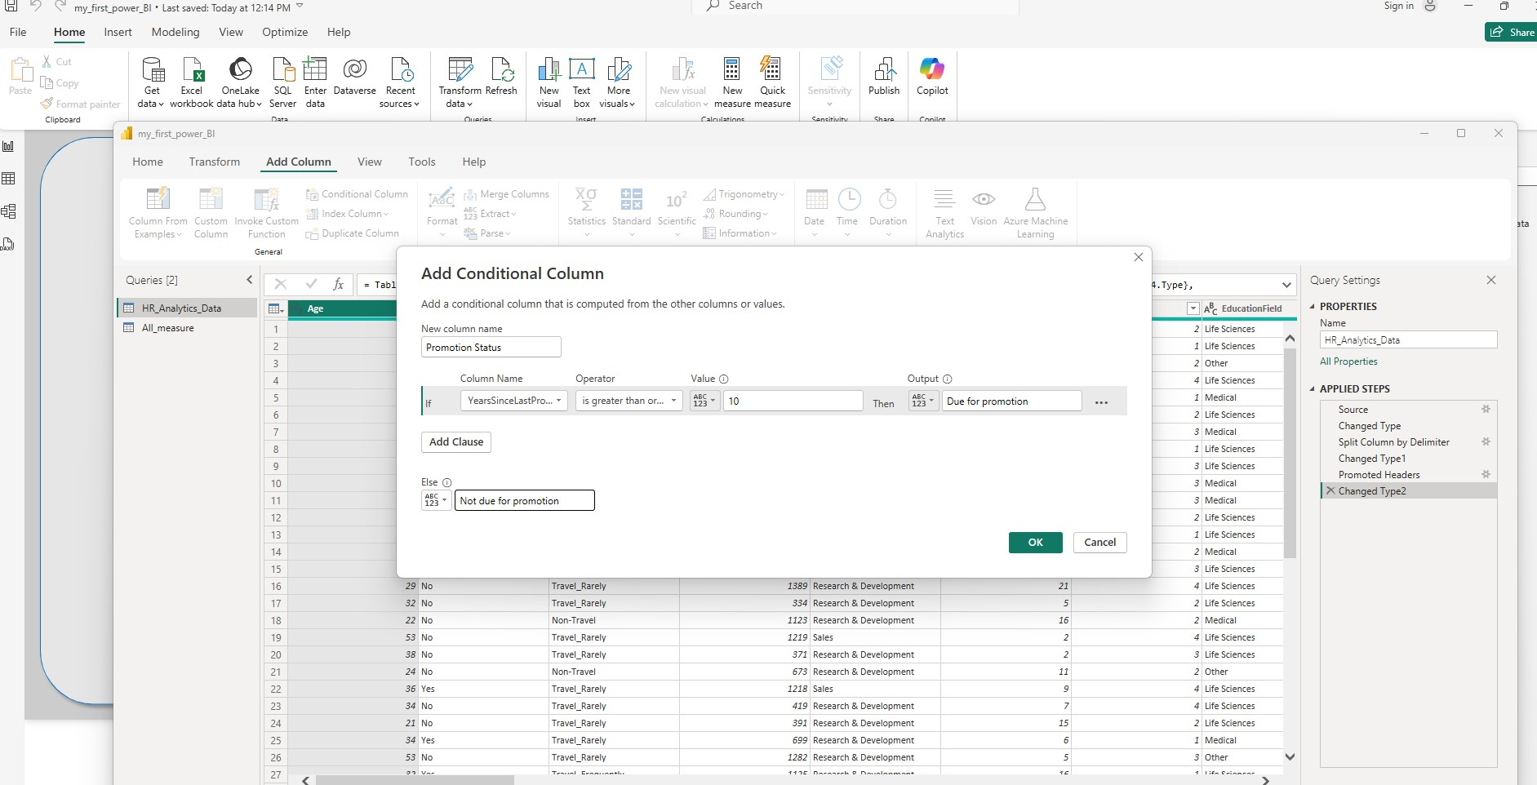
1) Now we add conditional column for people who have not recvd promotion for last 10 years: Home -> Transform data -> (A new window opens up) … Add column -> Conditional column
2) After the new conditional column is added, look at filters and see e/t is working. At the end clear the filters. Also change the data type of this new col to text
3) Go to Home -> Close and Apply

Slide 14
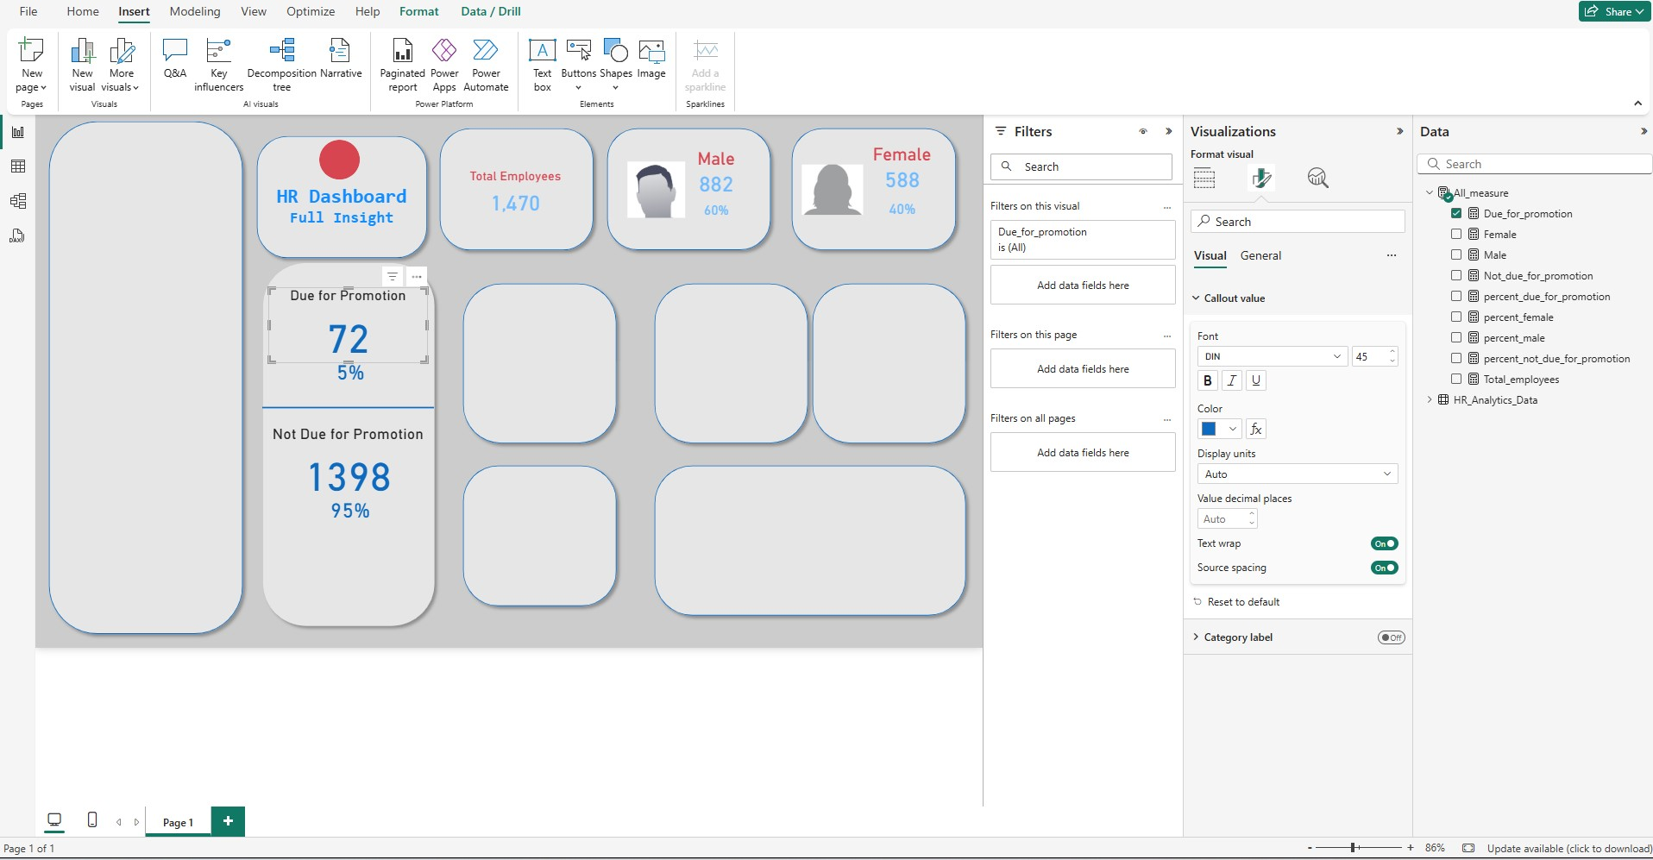
Now using previous new added column, we create following new measure:
Due_for_promotion = CALCULATE([Total_employees], HR_Analytics_Data[Promotional Status] = "Due for promotion")
Not_due_for_promotion = CALCULATE([Total_employees], HR_Analytics_Data[Promotional Status] = "Not due")
percent_due_for_promotion = DIVIDE([Due_for_promotion],[Total_employees],0)
percent_not_due_for_promotion = DIVIDE([Not_due_for_promotion],[Total_employees],0)
Add card for each one of the above

Slide 15
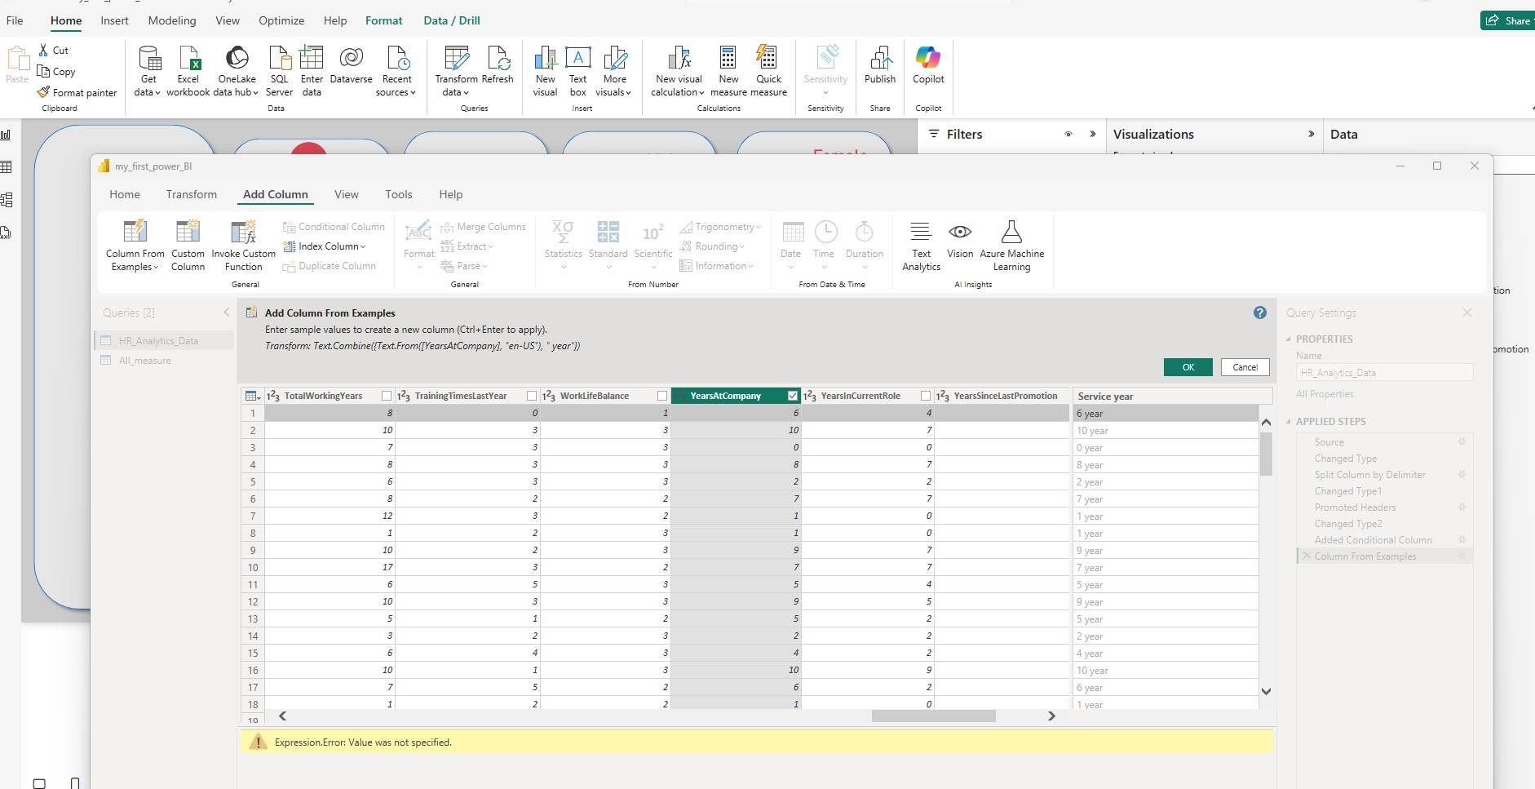
Now let’s add graph: Home -> Transform data -> select the HR_analytic_data -> Add column and select Column from example. From Selection -> You will see a new column1, change its name to Service year -> Now highlight and make sure to check selectbox of YearAtCompany column -> then goto Service year and type “the 1st entry of YearAtCompany year” and press enter-> This will populate, flash fill, the entire column

Slide 16
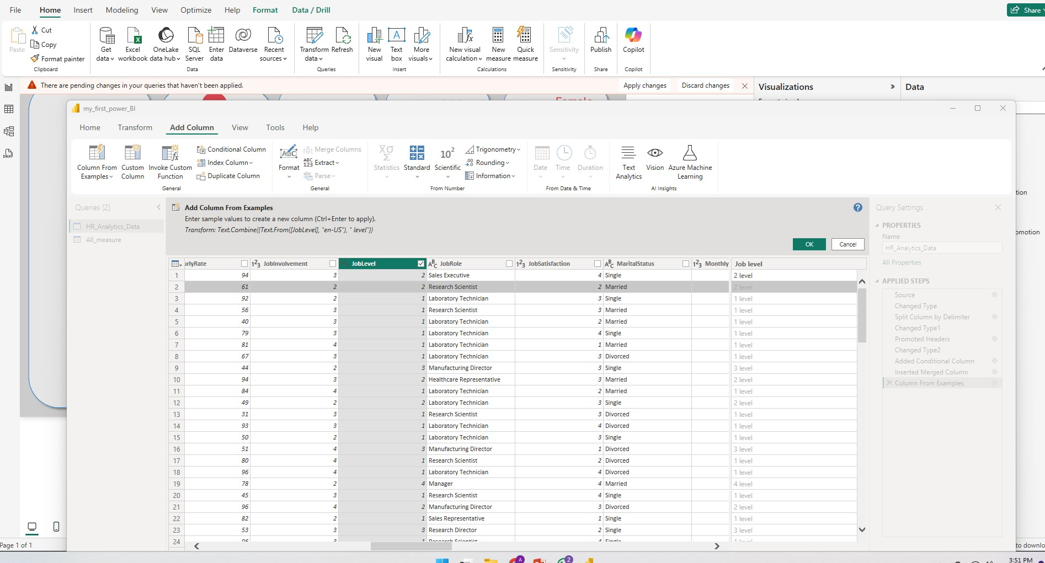
Do the same for Job levels
At the end, Home -> close and apply

Slide 17
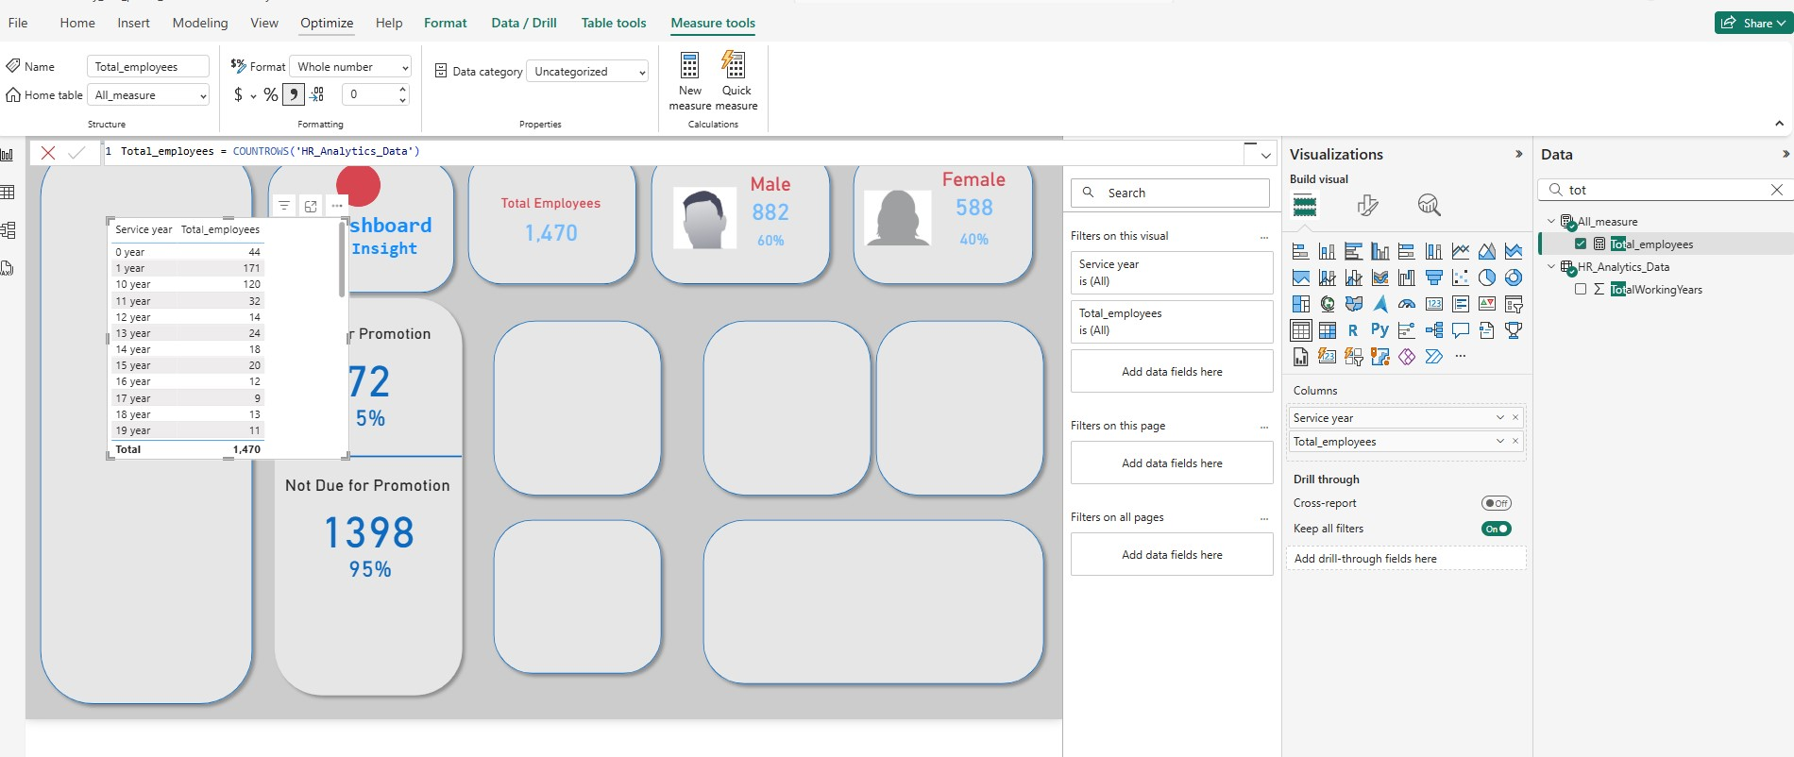
Select total employees and service years
Last step: Turn this into horizontal bar

Slide 18
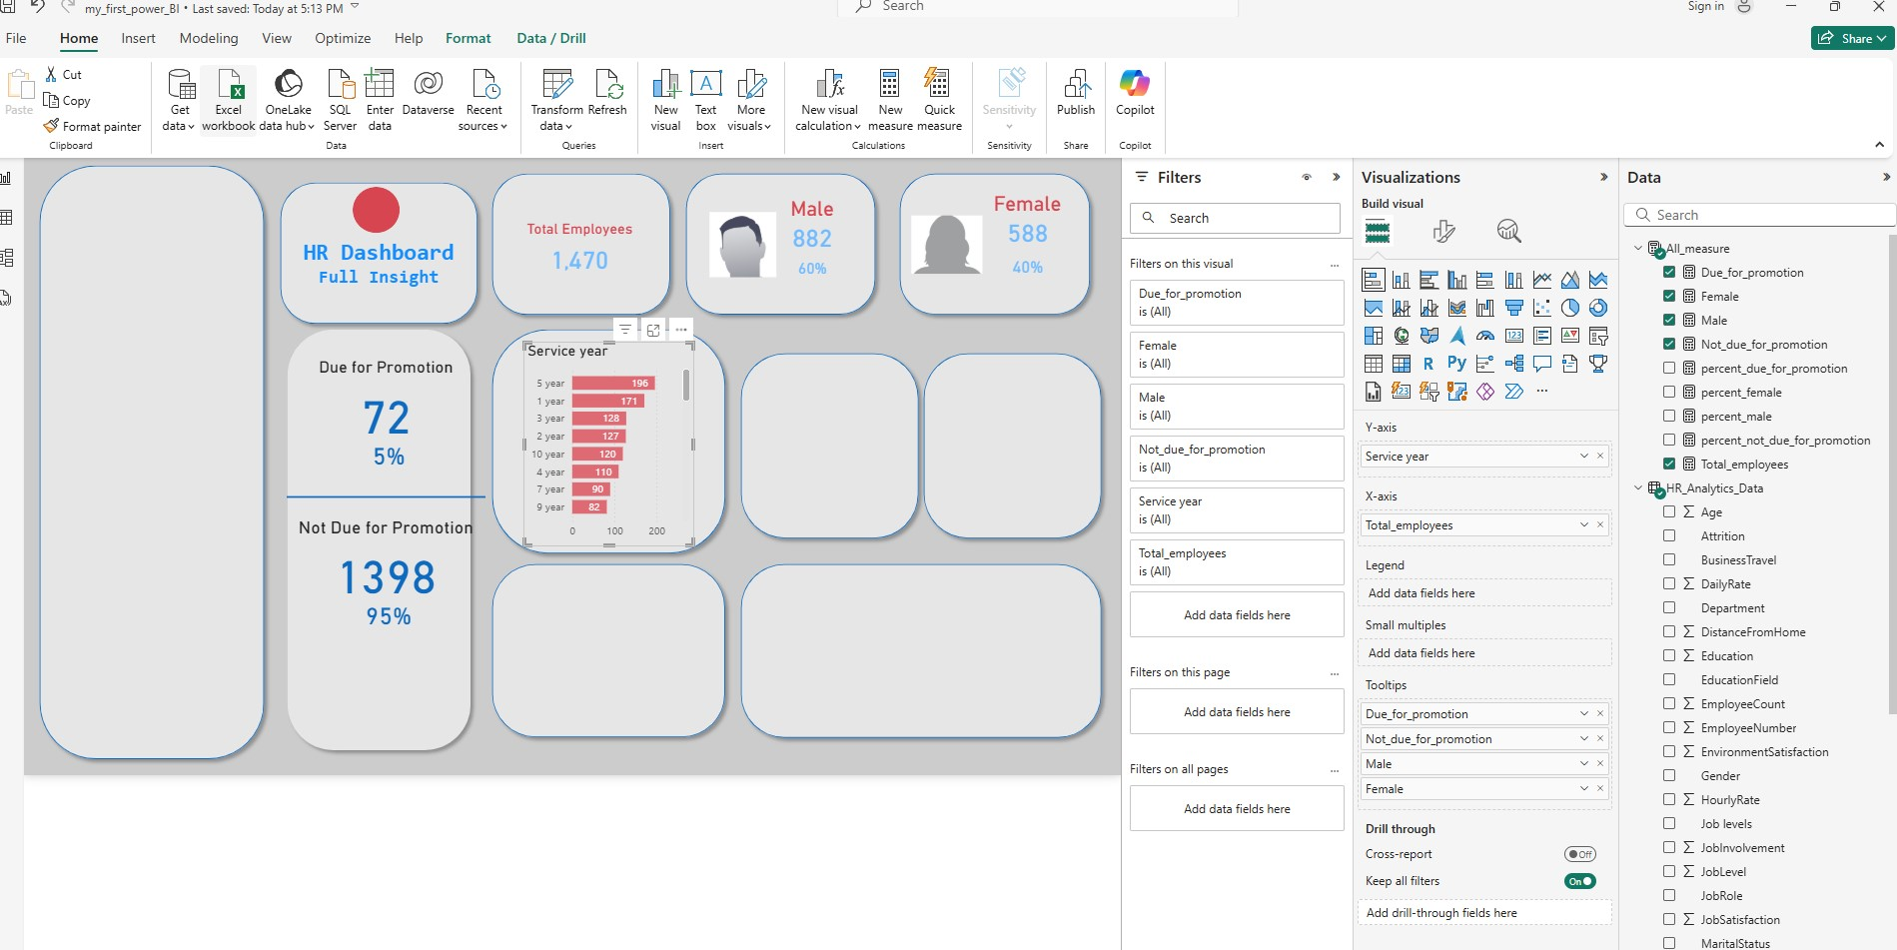
1) Change Title
2) turn off the title for x axis, turn off the title for y axis
3) change the colors of the bar
4) change the position of data label to inside
5) add to tooltips the entries from All_measure: Male, Female, Due_for_promotion, Not_due_for_promotion

Slide 19
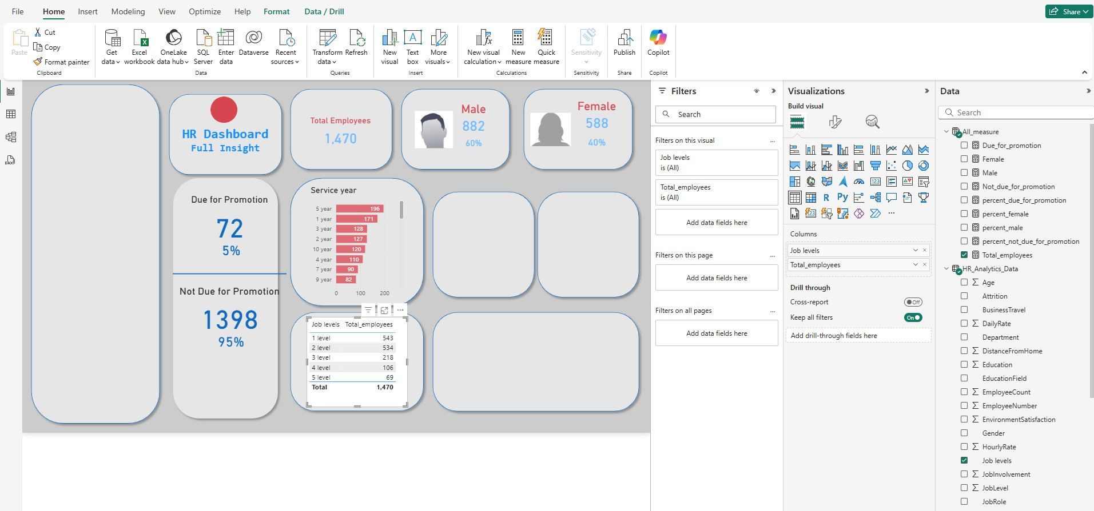
Now we do the same with Job Levels and Total_employees
Last step: click on the vertical bars

Slide 20
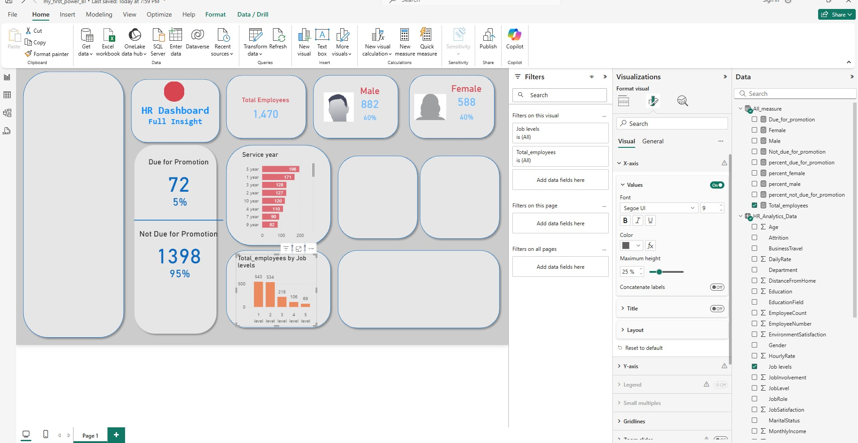

Slide 21
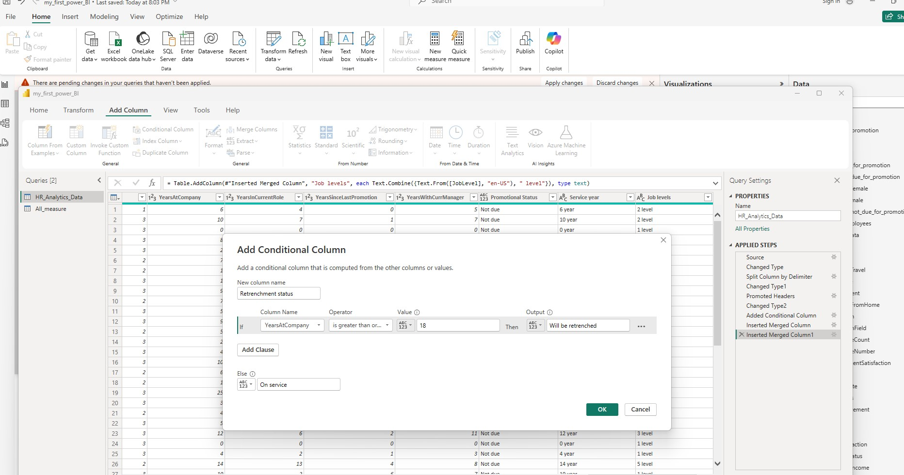
Now we add retrenchment status: Home -> Transform data -> Add column -> conditional column …we retrench people who have spent more than 18 years at company. -> Close and Apply

Slide 22
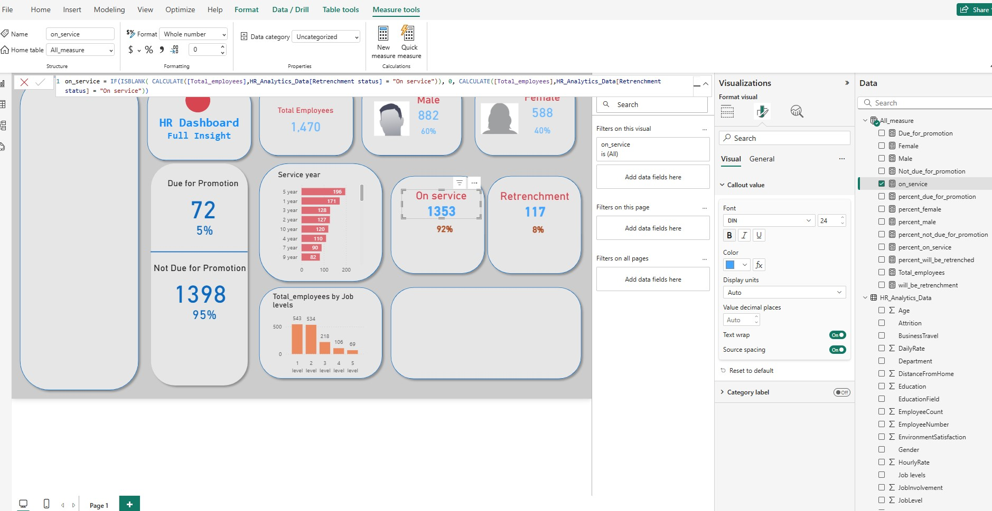
Now create a following 4 new measure
1) will_be_retrenchment = IF(ISBLANK( CALCULATE([Total_employees],HR_Analytics_Data[Retrenchment status] = "Will be retrenched")), 0, CALCULATE([Total_employees],HR_Analytics_Data[Retrenchment status] = "Will be retrenched"))
2) on_service = IF(ISBLANK( CALCULATE([Total_employees],HR_Analytics_Data[Retrenchment status] = "On service")), 0, CALCULATE([Total_employees],HR_Analytics_Data[Retrenchment status] = "On service"))
3) percent_will_be_retrenchment = DIVIDE([will_be_retrenchment],[Total_employees],0)
4) percent_on_service = DIVIDE([on_service],[Total_employees],0)

Slide 23
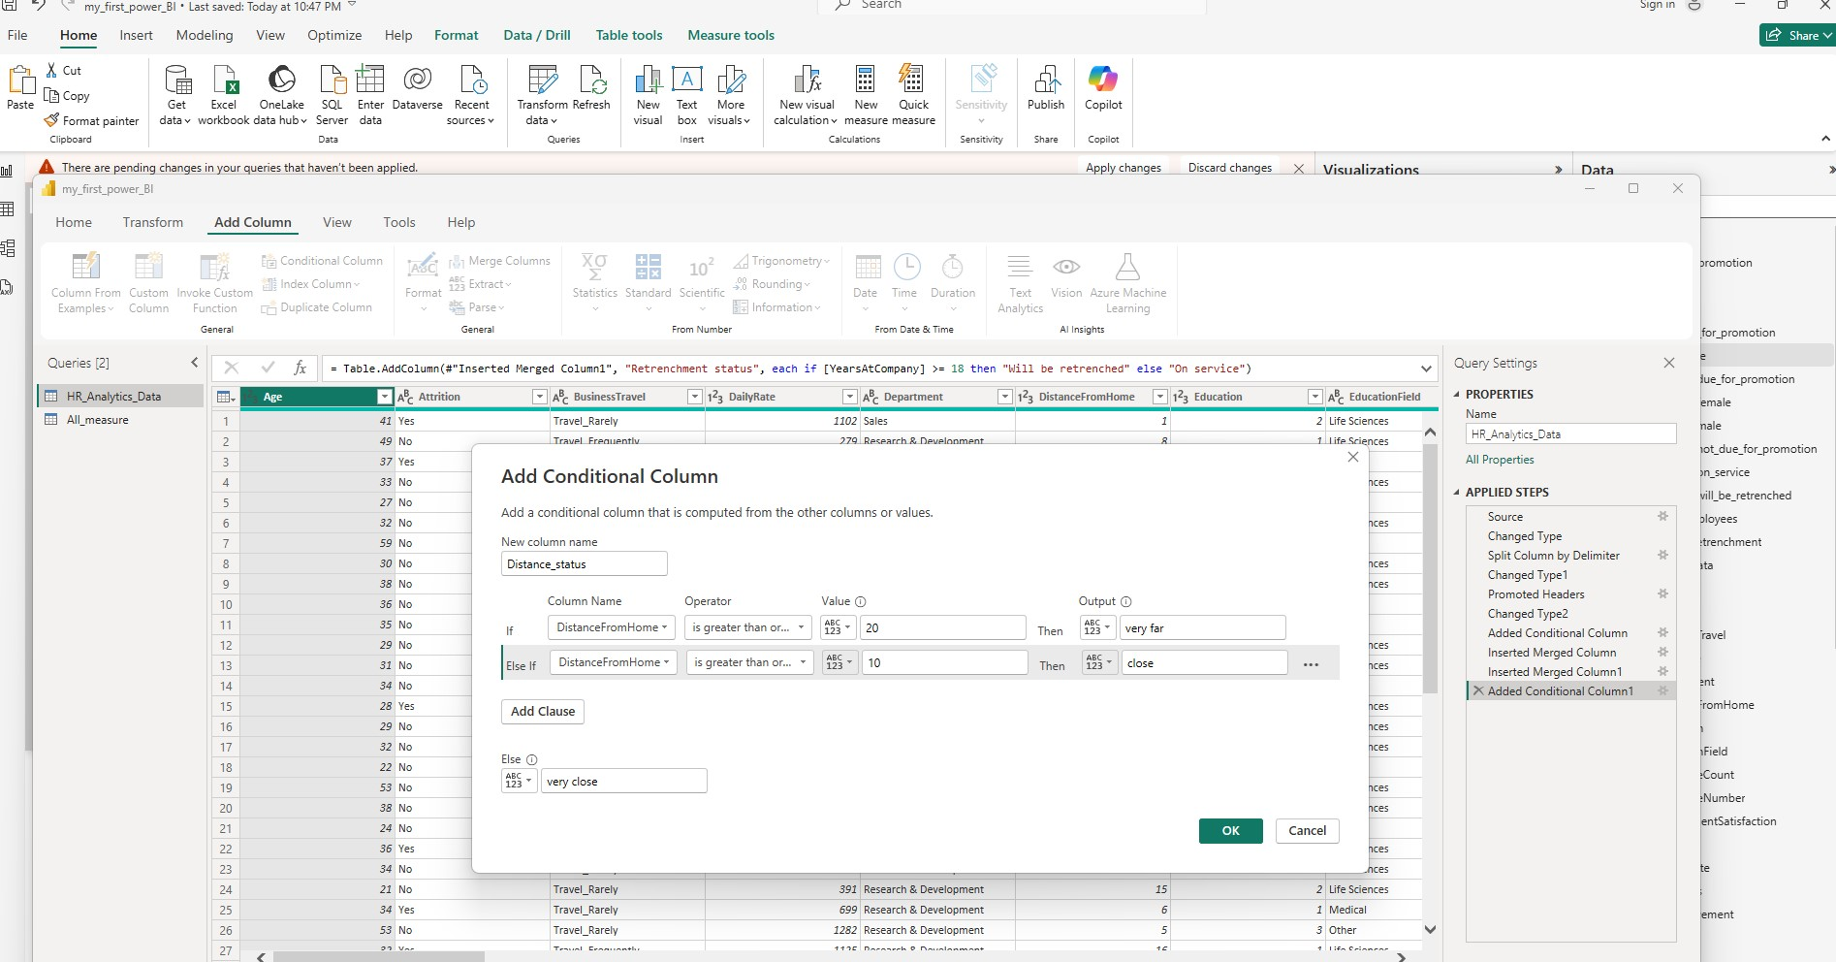
1) Now we create another measure related with distance from work: Home -> Transform data -> Add column -> conditional column ->(and see below)
2) It’s a good idea to change data type of each column that we added to ‘text’ that has text type value…(Do it for this new column) -> close and apply

Slide 24
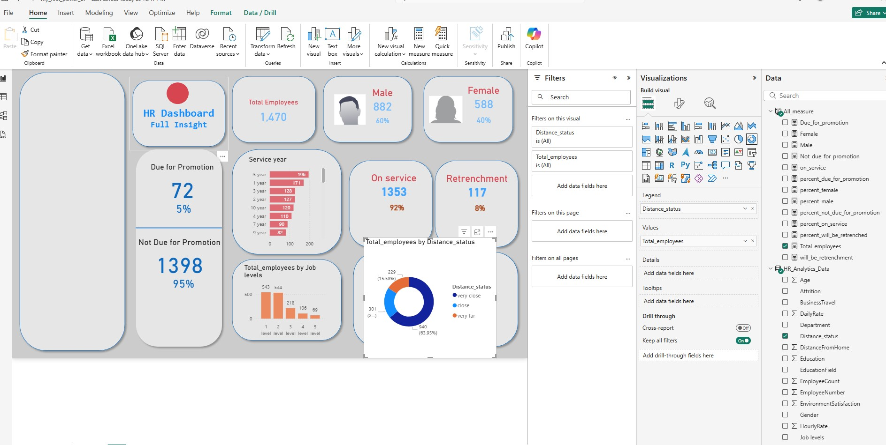
Now we create the donut chart: Select Distance_status -> select donut chart -> select Total_employee on All_measure and then u will see the proper donut chart

Slide 25
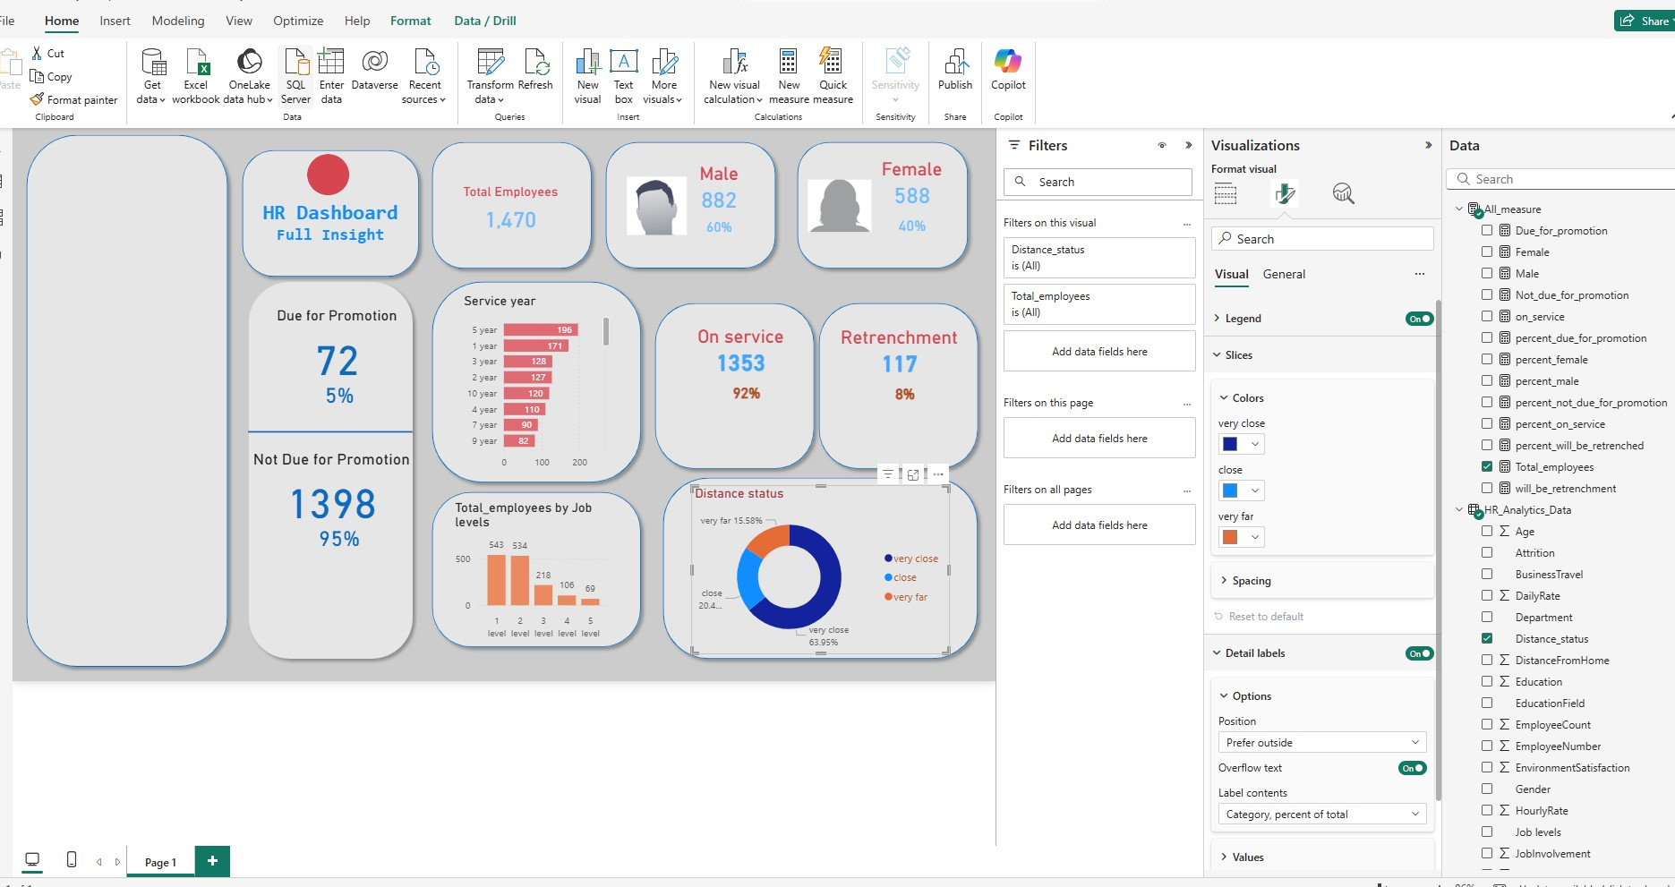
Now for the donut chart change the Title , slices, detail labels, legend

Slide 26
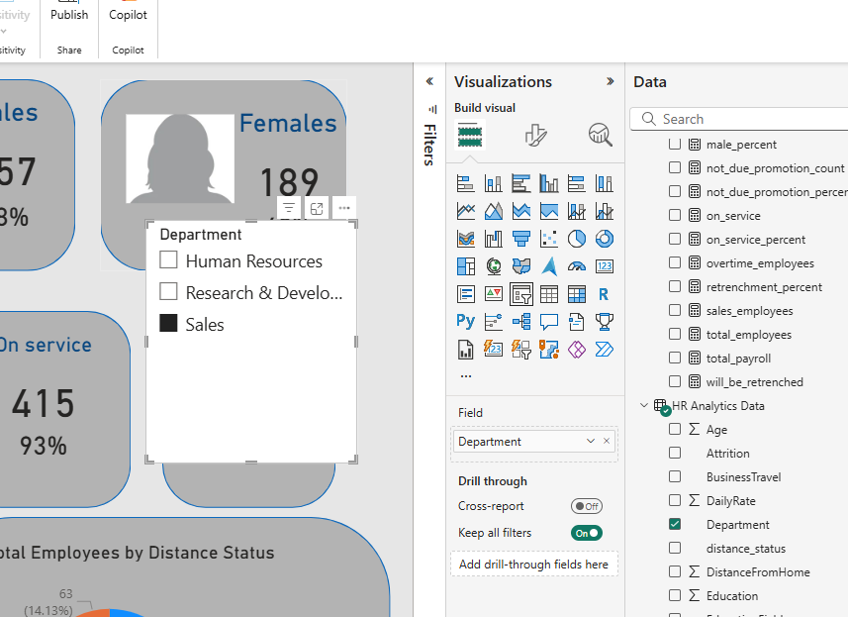


Slide 27
Few more measures:
total_payroll = SUM('HR Analytics Data'[MonthlyIncome])
average_age = AVERAGE('HR Analytics Data'[Age])
sales_employees =
CALCULATE(
COUNT('HR Analytics Data'[EmployeeCount]),
'HR Analytics Data'[Department] = "Sales"
)
hig_salary_employees =
CALCULATE(
COUNT('HR Analytics Data'[EmployeeNumber]),
FILTER('HR Analytics Data', 'HR Analytics Data'[MonthlyIncome] > 10000)
)
overtime_employees =
CALCULATE(
COUNT('HR Analytics Data'[EmployeeCount]),
'HR Analytics Data'[OverTime] = "Yes"
)

Slide 28
THE END

